Slide 1
CPE 323 Intro to Embedded Computer Systems System Architecture
Aleksandar Milenkovic
milenka@uah.edu

Slide 2
Admin

Slide 3
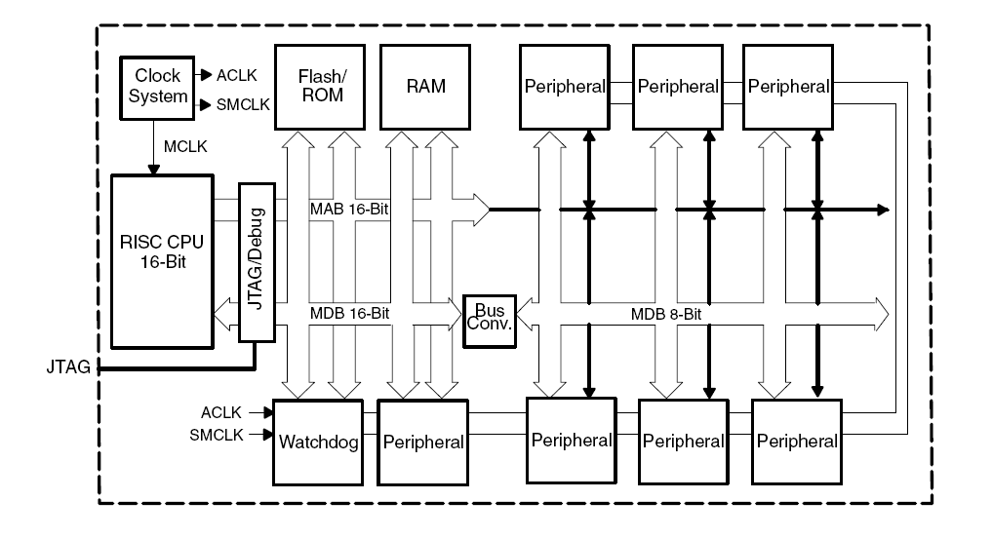
CPU, Memory, Peripherals, Bus (MAB, MDB)

Slide 4
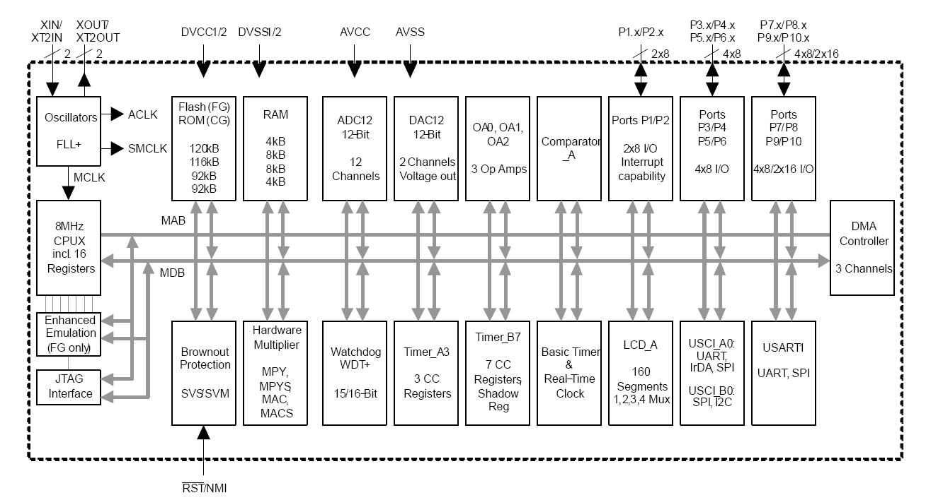
MSP430FG4618 Block Diagram

Slide 5
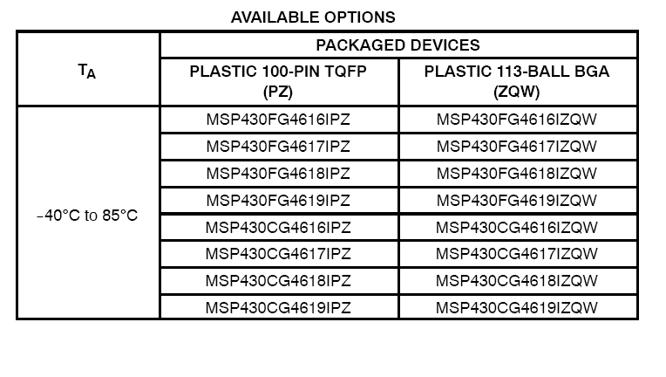
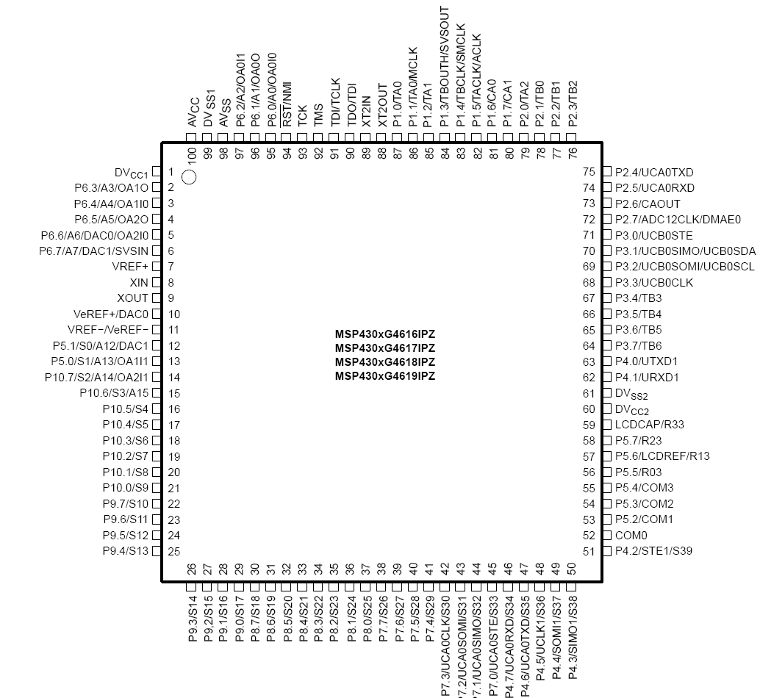
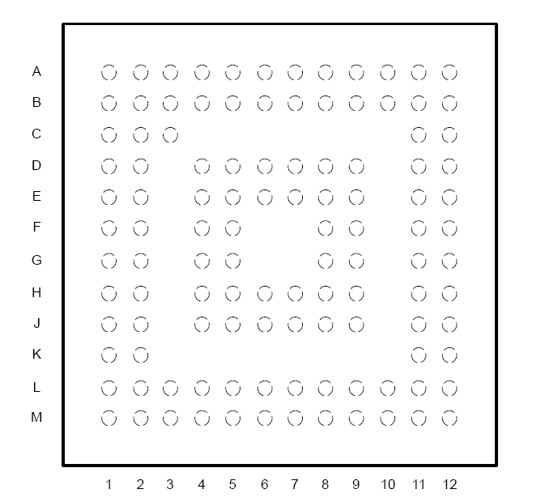
MSP430xG461x Microcontroller

Slide 6
MSP430F5529
A quad flat package (QFP) – surface mounted IC package, leads extend on all 4 sides: LQFP (low profile QFP), TQFP (thin QFP)
PN – Texas Instruments name of the package

Slide 7
Pin Diagram for MSP430F5529

Slide 8
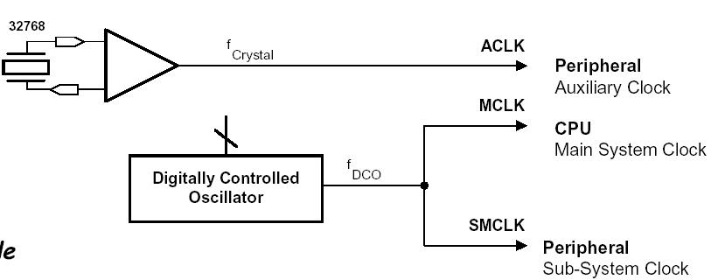
Clock Subsystem
Generate clocks used by components on the chip
Configured and tuned by software, enable/disable clocks for Low-Power Modes
Multiple types (FLL+, Basic Clock Module)
Three clocks are available:
Main clock (MCLK): CPU, DMA, selected peripherals
Sub-system clock (SMCLK): peripherals
Auxiliary clock (ACLK): peripherals

Slide 9
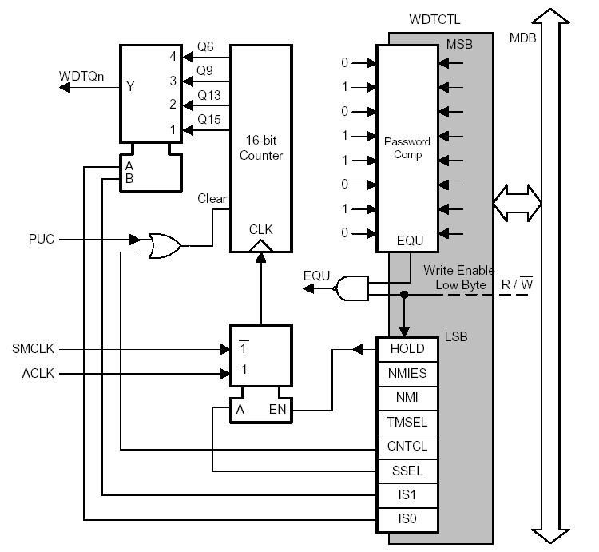
Watchdog Timer
Monitors system operation
Two modes of operation
Watchdog
Interval timer
Watchdog: performs controlled system reset if a software error occurs
Interval timer: generates an regular periodic interrupt
Active on power-up

Slide 10
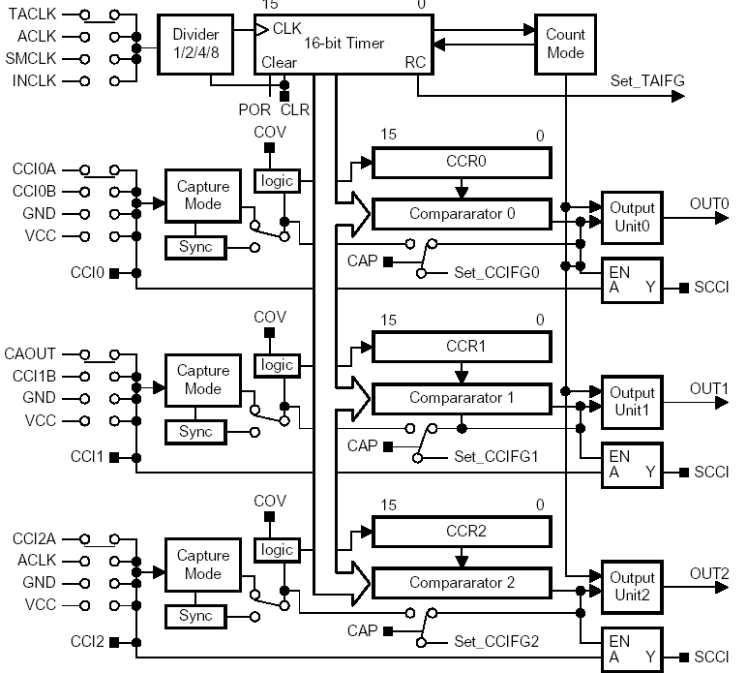
Timers (Timer_A, Timer_B)
Time keeping
Timer block: counter
Capture&Compare block: logic where action occurs
Two main functions
Capture
Compare
Capture: monitor external events (signal transitions) and timestamp them when a change is detected
Compare: produce PWM signals, compare running counter to predefined values in CCRx and trigger a change in a signal

Slide 11
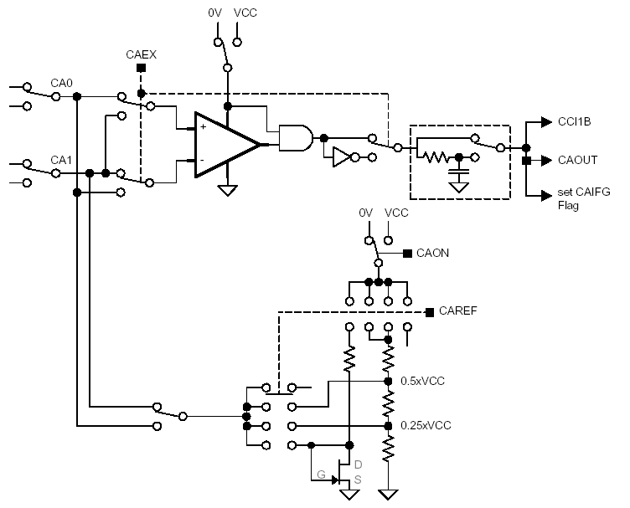
Comparator (Comparator_A)
Compare an analog signal to a reference voltage and produces a binary output (1 if Vin≥Vref, 0 otherwise)
Supports precision slope analog-to-digital conversions
Supply voltage supervision
Monitoring of external analog signals

Slide 12
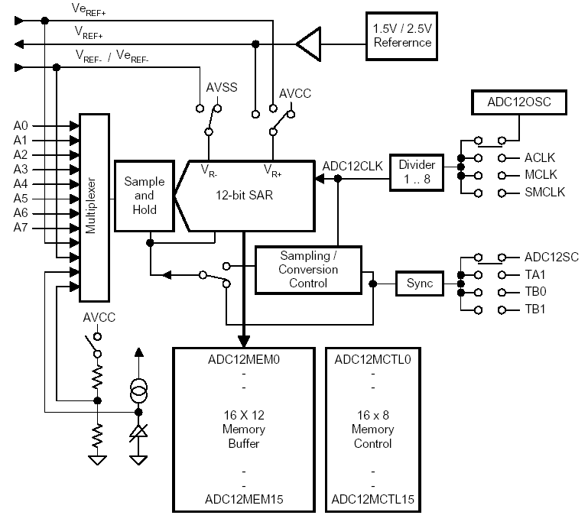
Analog-to-Digital Converter (ADC12)
Convert analog signals to binary counterparts
ADC12:
12-bit resolution
200 Ksamples/s
8 external inputs
Local memory
Programmable sample time
Selectable reference voltages

Slide 13
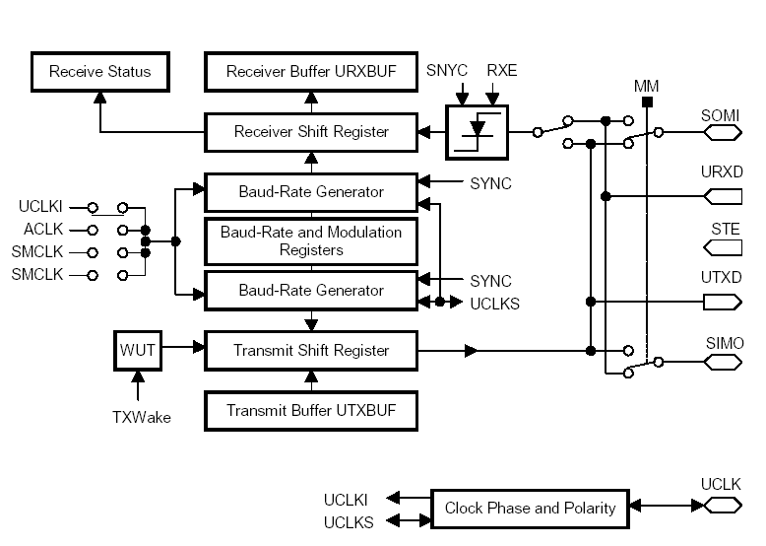
Serial Communication Interfaces (USCI, USART, USI)
Support for synchronous and asynchronous serial communication
UART
SPI
I2C
Infrared

Slide 14
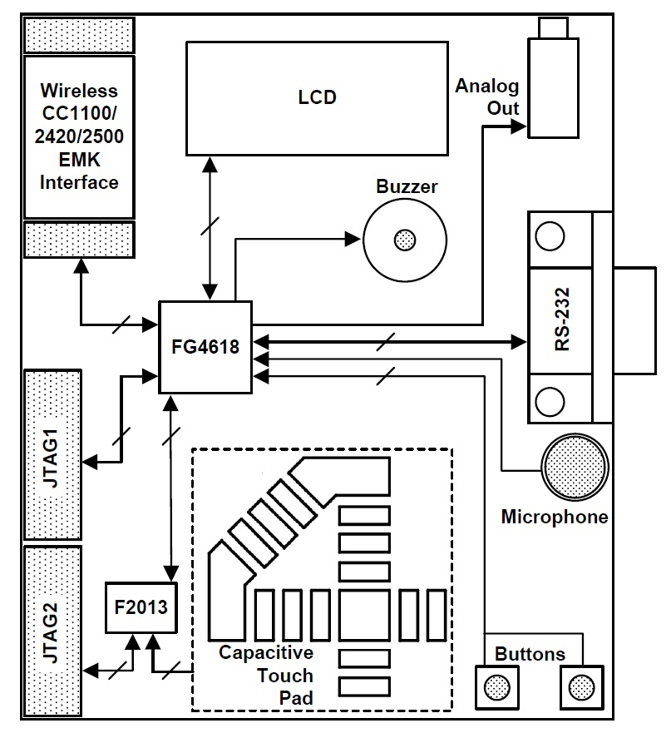
TI Experimenter’s Board: Block Diagram
Microcontroller’s (F4618, F2013)
JTAGs
Buttons/Switches
Capacitive Touch Pad
Microphone
Buzzer
LCD
Wireless Interface
RS232

Slide 15
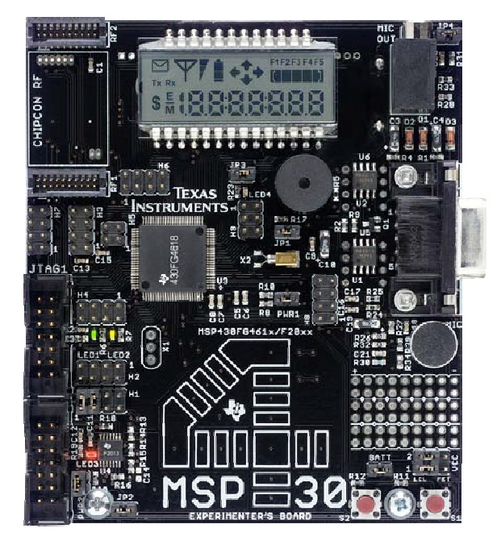
TI Experimenter’s Board
Two on-board CPUs
MSP430FG4618
MSP430F2013
The Softbaugh SBLCDA4 LCD display
4-MUX operation and is interfaced to the MSP430FG4618 LCD driver peripheral
Momentary Push-ON Buttons
S1 and S2 are connected to pins on Port 1 (P1) of the MSP430FG4618
Light Emitting Diodes (LEDs)
Four LEDs, three of which are connected to the MSP430FG4618, and one connected to the F2013.
Buzzer
Connected to one of the MSP430FG4618 port pins and can be disabled using jumper JP1

Slide 16
TI Experimenter’s Board
Single-Touch Capacitive Sensing Interface
A 16-segment touch pad in the shape of a “4” is connected to the data pins of the MSP430F2013, which then relays the data to the MSP430FG4618 using the inter-processor communications peripherals on each CPU
RS232 Serial Communication Port
A standard 9-pin serial communications port is connected to the MSP430FG4618 USCI peripheral and can be used when the USCI is configured in UART mode
Microphone & Analog Out
A microphone is connected to a port pin of the MSP430FG4618, and the input to the 3.5mm analog out can be connected to the output from the MSP430FG4618’s 12-bit digital to and analog (DAC12) convertor
Radio
Wireless Communication Module Interface

Slide 17
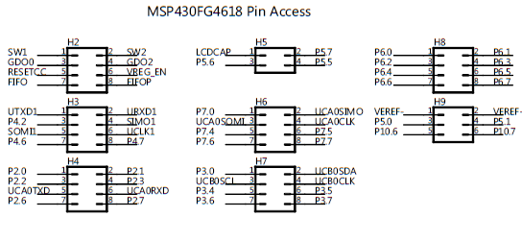
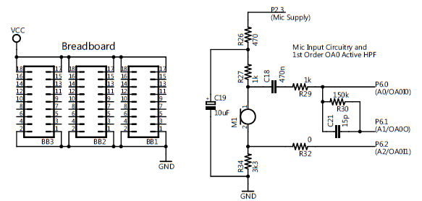
Headers

Slide 18
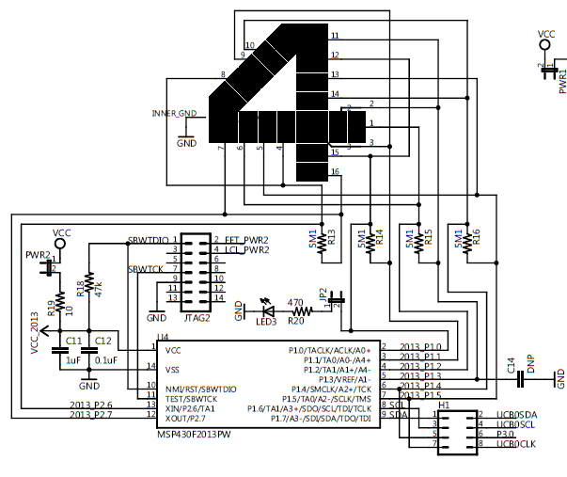
Capacitive Touch Pad

Slide 19
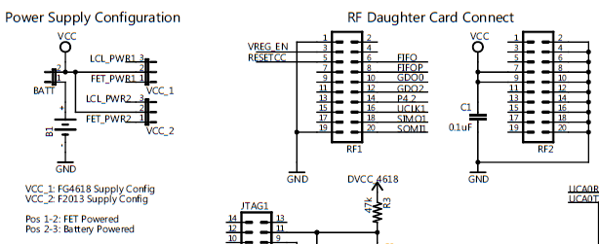
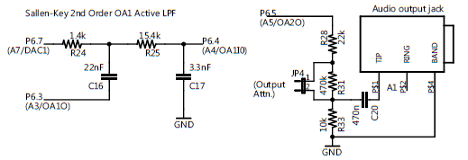
Power Supply Configuration, RF Daughter Card Connect, Audio Output

Slide 20
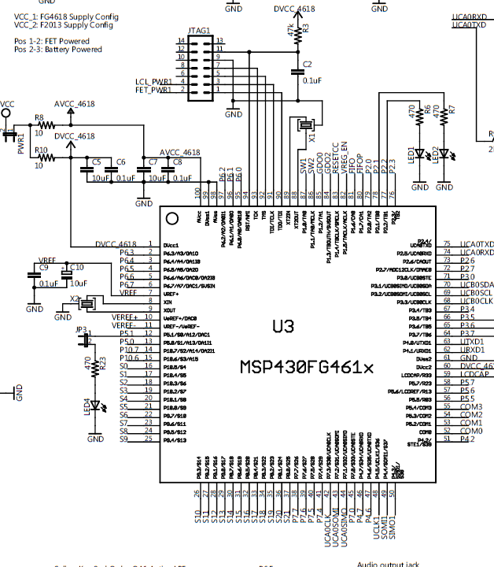
MSP430FG4618

Slide 21
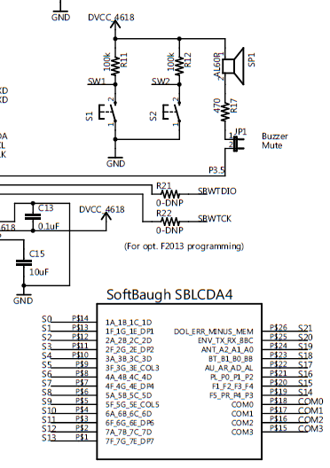
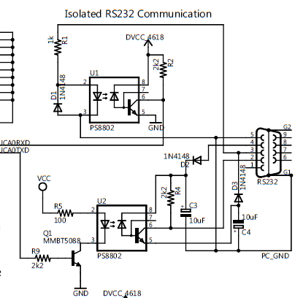
RS232 Connector, LCD Display

Slide 22
Blink a LED Program
/****************************************************************************
; TI Experimenter board demo, blinking leds LED1 and LED2 (msp430FG4618)
; Description: Toggle P2.1 and P2.2 by xoring P2.1 and P2.2 inside a loop.
; The LEDs are connected to P2.1 and P2.2 and are on when
; P2.1=1 and P2.2=1;
; The LEDs are initialized P2.1 to be off, and P2.2 to be on;
; ACLK = 32.768kHz, MCLK = SMCLK = default DCO
; MSP430xG461x
; -----------------
; /|\| |
; | | |
; --|RST |
; | P2.2|-->LED1(GREEN)
; | P2.1|-->LED2(YELLOW)
; Alex Milenkovich, milenkovic@computer.org
;****************************************************************************/
#include "msp430xG46x.h"
void main(void)
{
WDTCTL = WDTPW + WDTHOLD;// Stop watchdog timer
P2DIR |= 0x06; // Set P2.1&P2.2 to output direction (0000_0110)
P2OUT = 0x02; // Set P2OUT to 0x0000_0010 (LED2 is on, LED1 is off)
for (;;) {
unsigned int i;
P2OUT ^= 0x06; // Toggle P2.1 using exclusive-OR
i = 50000; // Delay
do (i--);
while (i != 0);
}
}

